Slide 1
Department of Artificial Intelligence and Machine Learning
QUARANTINE BAND
Puja S 1BY19AI040
Putluru Yashwanth 1BY19AI041
Rahul Srivastava 1BY19AI042
Under the guidance of:
Dr. Anupama H S
Designation, AI & ML
BMSIT & M
2020-21
ODD Semester

Slide 2
Department of Artificial Intelligence and Machine Learning
Contents
Introduction
Objectives
Literature Survey
Proposed Methodology
System Architecture/ Design
Subject Mapping

Slide 3
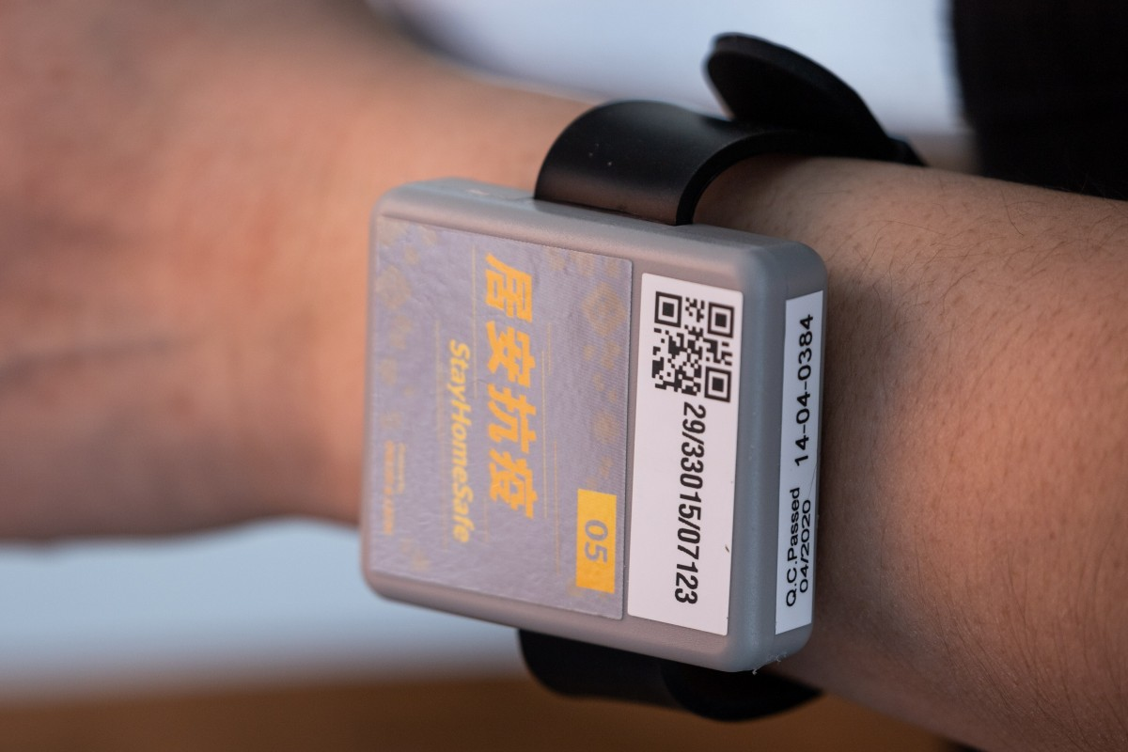
Department of Artificial Intelligence and Machine Learning
Introduction
Basic features:
Locked and activated once worn
Highly Secured
Measures Temperature , Heart rate and SPO2 levels.

Slide 4
Department of Artificial Intelligence and Machine Learning
Objectives
Highly Secured
Cost effective
Highly Reliable
Data Accuracy
Waterproof and skin friendly

Slide 5
Department of Artificial Intelligence and Machine Learning
Literature Survey
Hong Kong Govt. designed a wristband for its overseas Travellers.
Abu Dhabi IT Manager designed a wristband “My Quarantine”.
South Korea developed an Electric Wristband for those who defy quarantine orders.
Mysuru students designed wristband “Goaway bands”

Slide 6
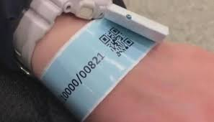
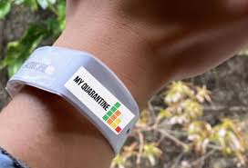
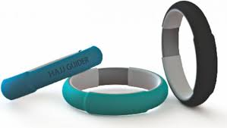
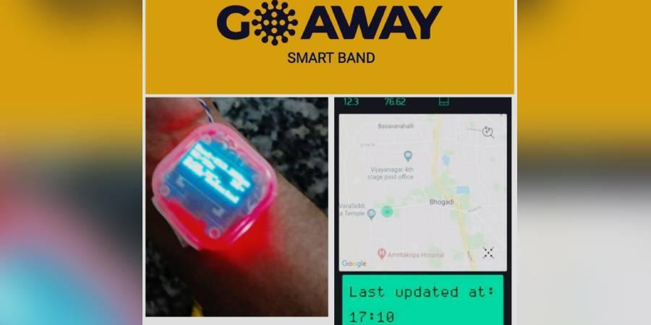
Department of Artificial Intelligence and Machine Learning

Slide 7
Department of Artificial Intelligence and Machine Learning
Proposed Methodology
Rectified disadvantages in existing models
Secure system
Good battery life
High accuracy

Slide 8
Department of Artificial Intelligence and Machine Learning
System Architecture/Design
Important components:
Aurduino Nano
MAX30105
ESP32

Slide 9
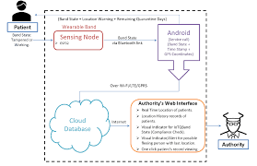
Department of Artificial Intelligence and Machine Learning

Slide 10
Department of Artificial Intelligence and Machine Learning
Subject Mapping
Math (18MAT31):
Temperature conversion from Fahrenheit to Celsius
Data Structures and Applications(18CS32):
Instructions given to the Aurduino by using “C” or “Python”
Analog to Digital Electronics(18CS33):
Use of sensors such as MAX30105

Slide 11
Department of Artificial Intelligence and Machine Learning
Computer Organization(18CS34):
Use of microcontroller (Aurduino nano)
Software Engineering(18CS35):
Open-Source Arduino Software (IDE) makes it easy to write code and upload to board
Discrete Mathematical Structures(18CS36):
Pictorial representation of the no. of recoveries , violated the norms , etc.

Slide 12
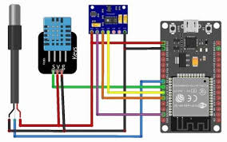
Department of Artificial Intelligence and Machine Learning
SCHEMATIC DIAGRAM

Slide 13
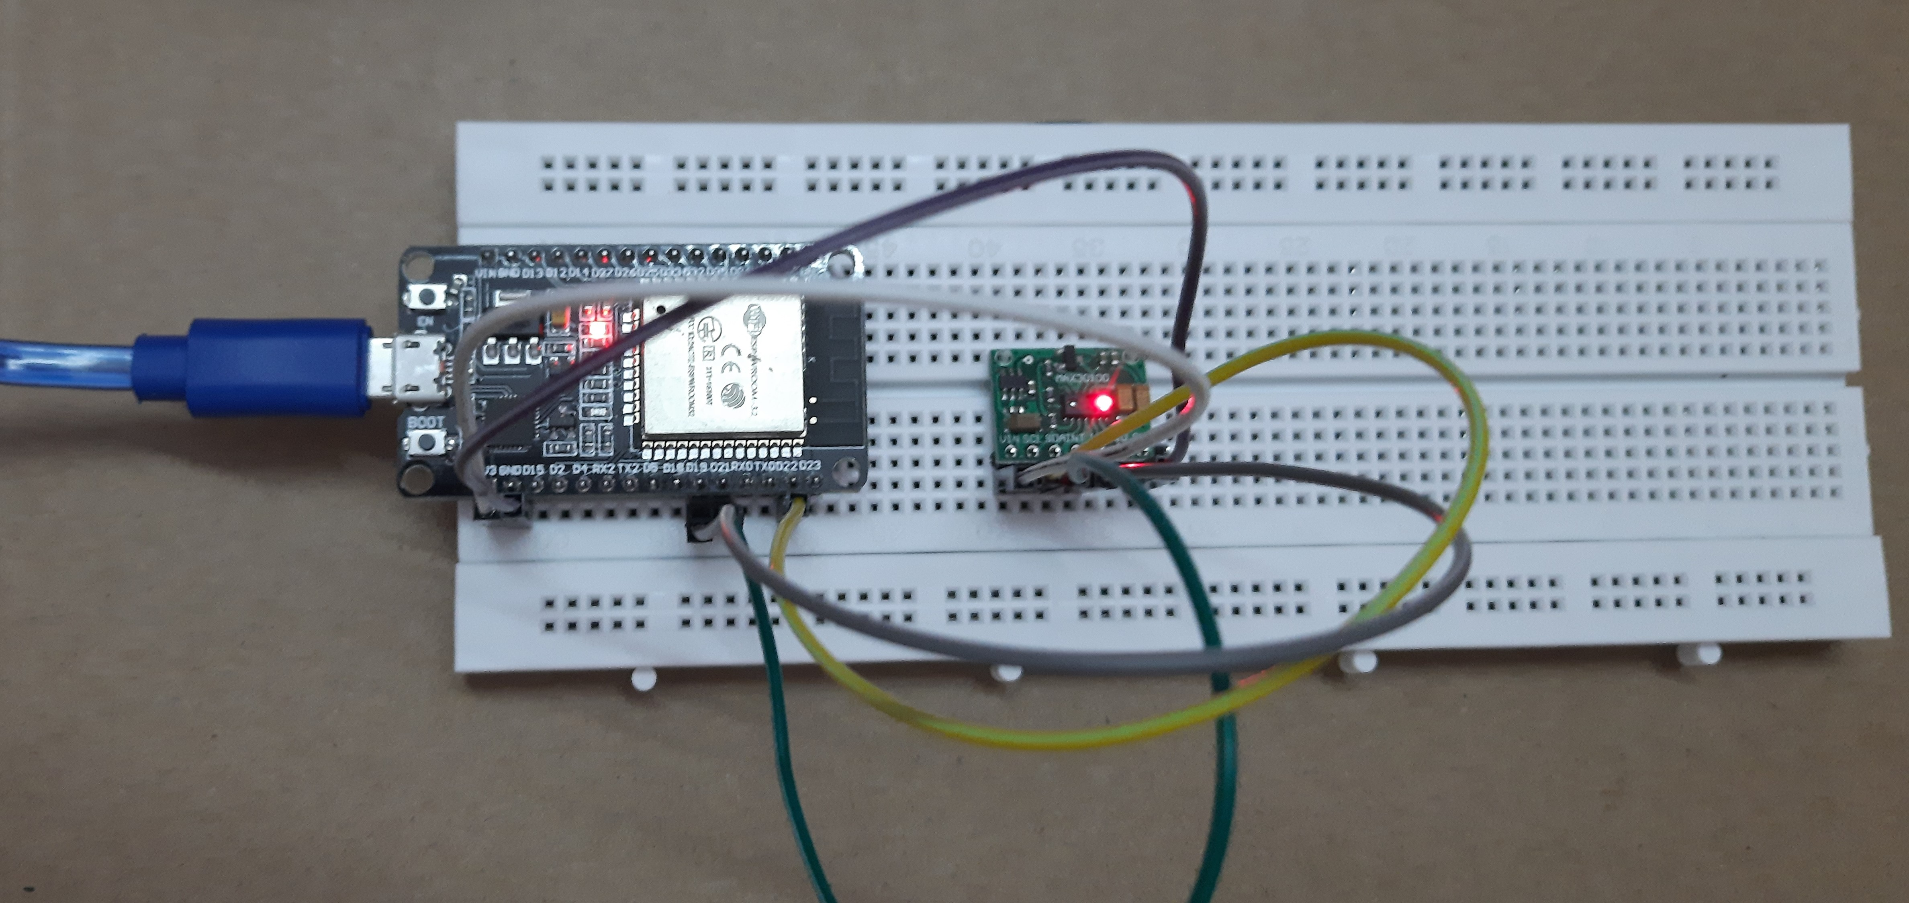
Department of Artificial Intelligence and Machine Learning
CONNECTIONS

Slide 14
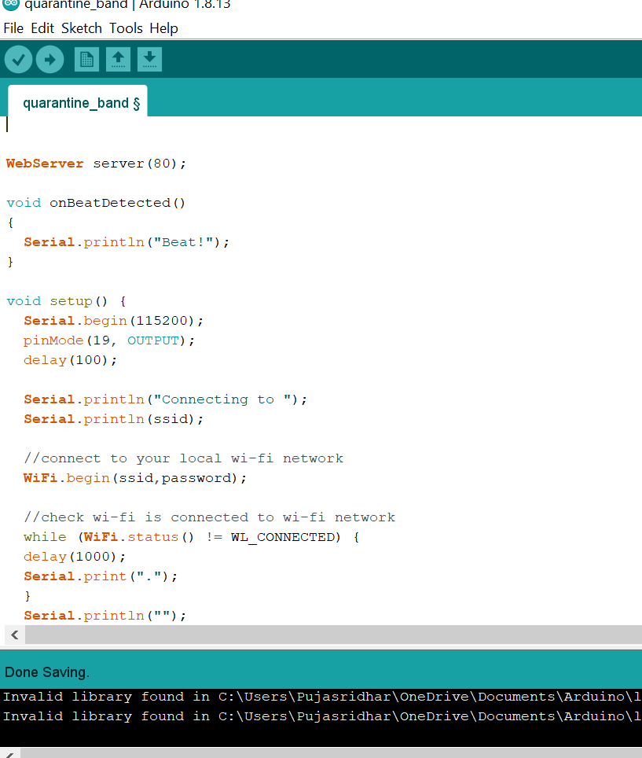
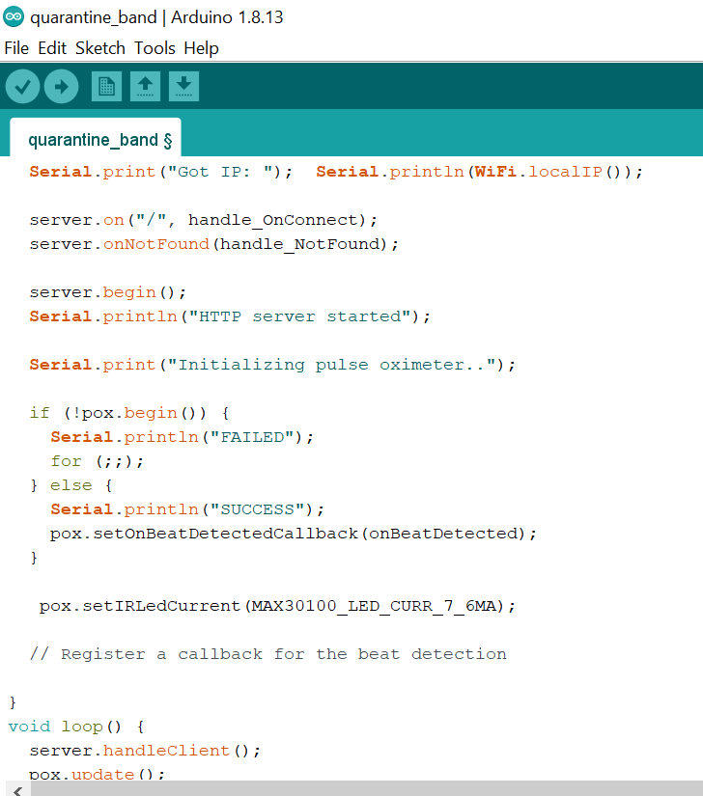
Department of Artificial Intelligence and Machine Learning
CODE

Slide 15
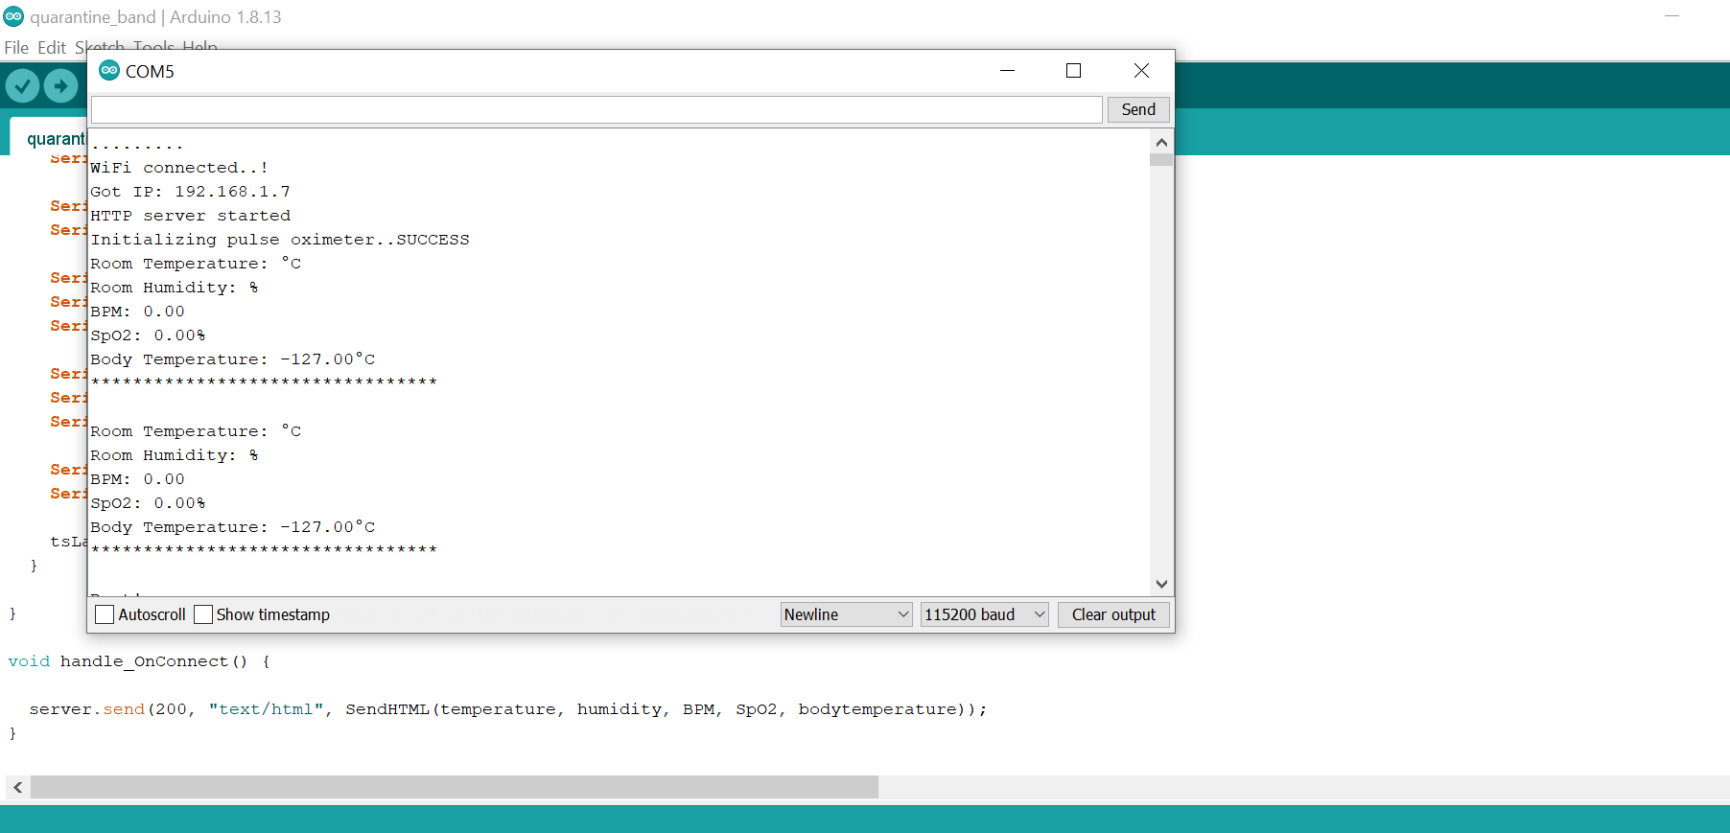
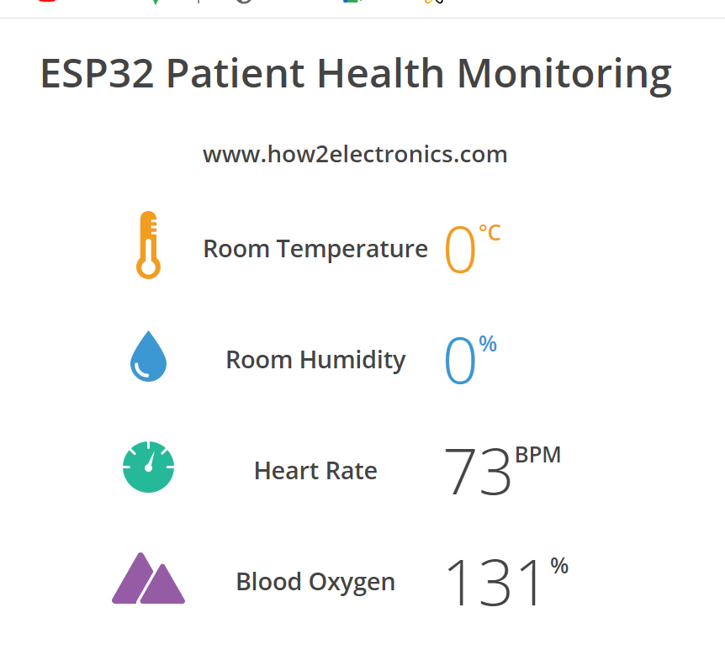
Department of Artificial Intelligence and Machine Learning
OUTPUT

